Slide 1



Bank Loan Analysis
Presented By:
Group 3

Slide 2
Group Members
1. Menaka BM
2. Sushant Gavit
3. Sanjana Murthy
4. Varad Gurav
5. Vilma D’Souza
6. Bhavesh Rana
7. Erodula Yuktha

Slide 3
Introduction:
Bank analysis involves a multifaceted examination of a financial institution's stability, performance, and risk management strategies.
Integral to this assessment is a thorough review of the bank's financial statements, including the balance sheet, income statement, and cash flow statement, to gauge its profitability, liquidity, and operational efficiency through various financial ratios.
Capital adequacy is assessed to ensure the bank has a robust buffer against potential losses, while liquidity analysis examines its ability to meet short-term obligations and withstand liquidity stress. Attention is also paid to the bank's interest rate risk management, regulatory compliance, market position, and competitive landscape.
Furthermore, an analysis of risk management practices and qualitative factors such as management quality and corporate governance provides a comprehensive understanding of the bank's overall health and prospects in the financial marketplace.

Slide 4
Objectives:
A bank loan analysis project is a critical undertaking that helps financial institutions understand and manage their loan portfolios effectively. Some key objectives are:
Continuously monitor the performance of existing loans to identify potential issues such as late payments, defaults, or other signs of financial stress. This allows the bank to take timely action to mitigate risks.
Evaluate the creditworthiness of potential borrowers to determine the risk associated with extending loans to them. This includes assessing factors such as income, employment history, credit score, and debt-to-income ratio.
Classify customers into different segments based on their loan history, risk level, and other characteristics. This allows the bank to tailor its offerings and services to meet the needs of different customer groups.
Evaluate the profitability of different types of loans and borrowers to help the bank allocate resources effectively and prioritize certain types of lending.
Understand customer needs and preferences, which can help in building stronger relationships with customers and providing personalized services.

Slide 5
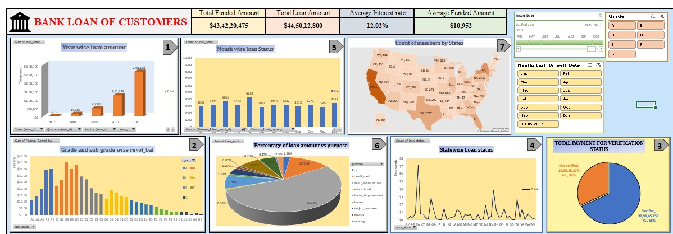
Excel Dashboard:

Slide 6
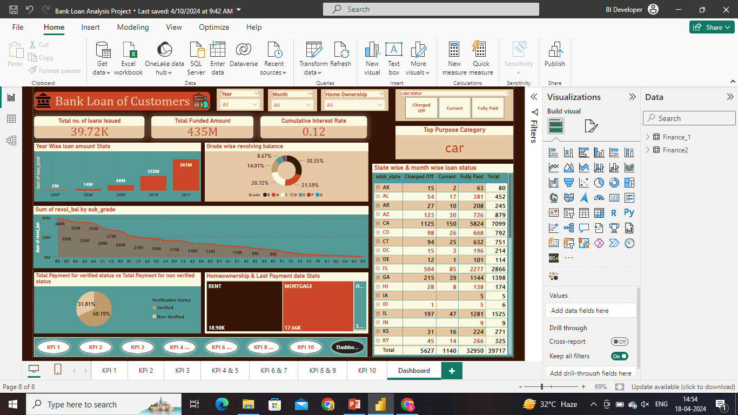
Power Bi Dashboard:

Slide 7
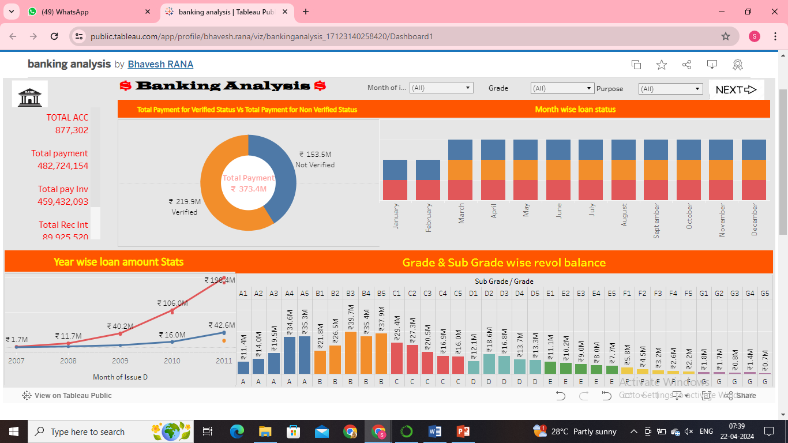
Tableau Dashboard:

Slide 8
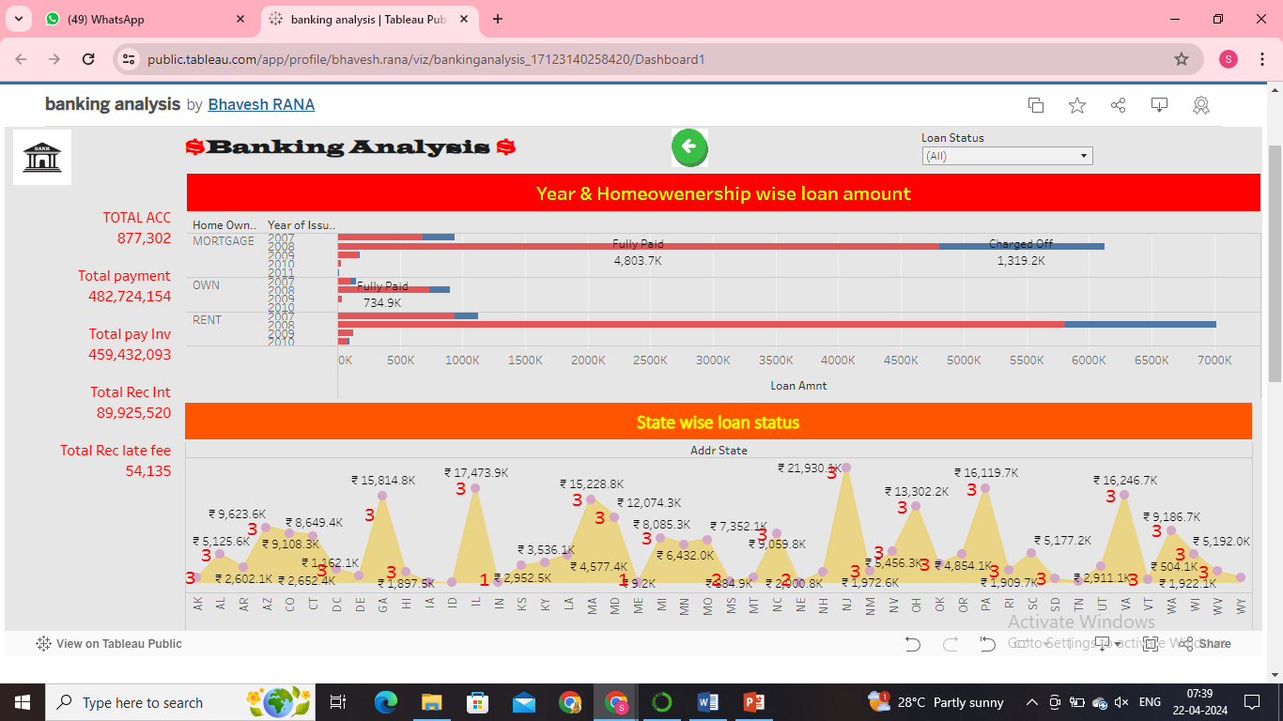
Tableau Dashboard:

Slide 9
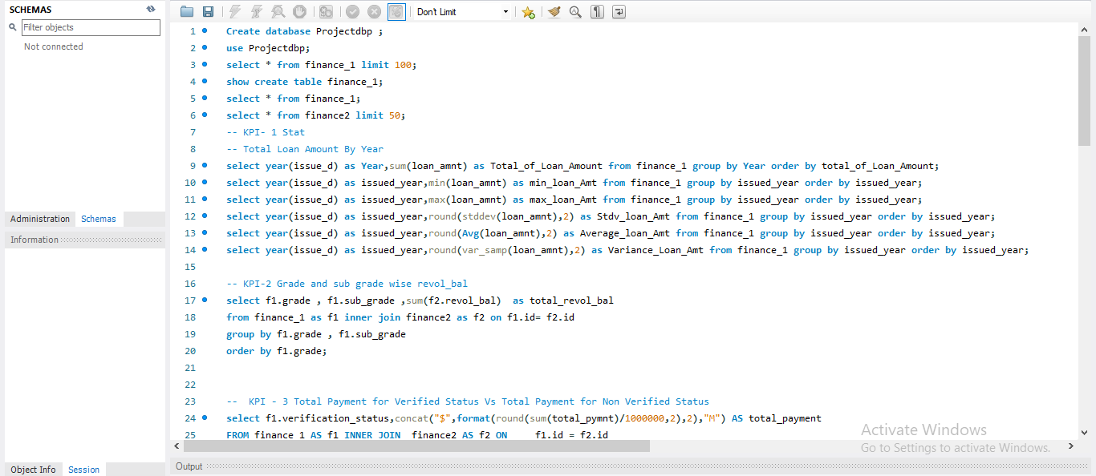
MySQL:

Slide 10
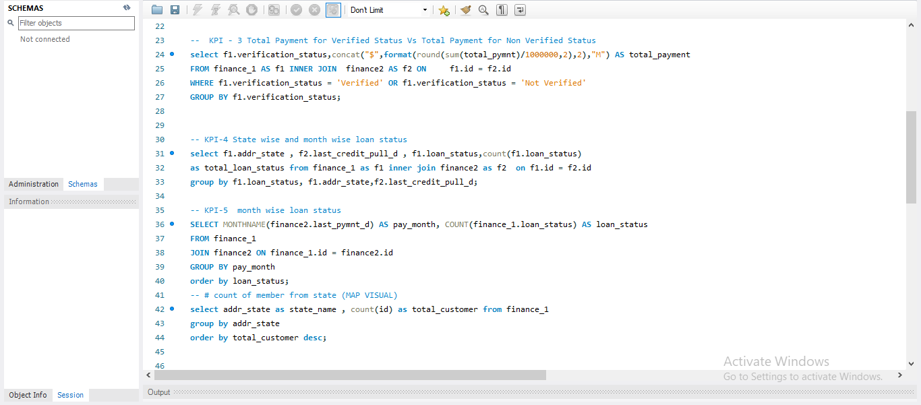
MySQL:

Slide 11
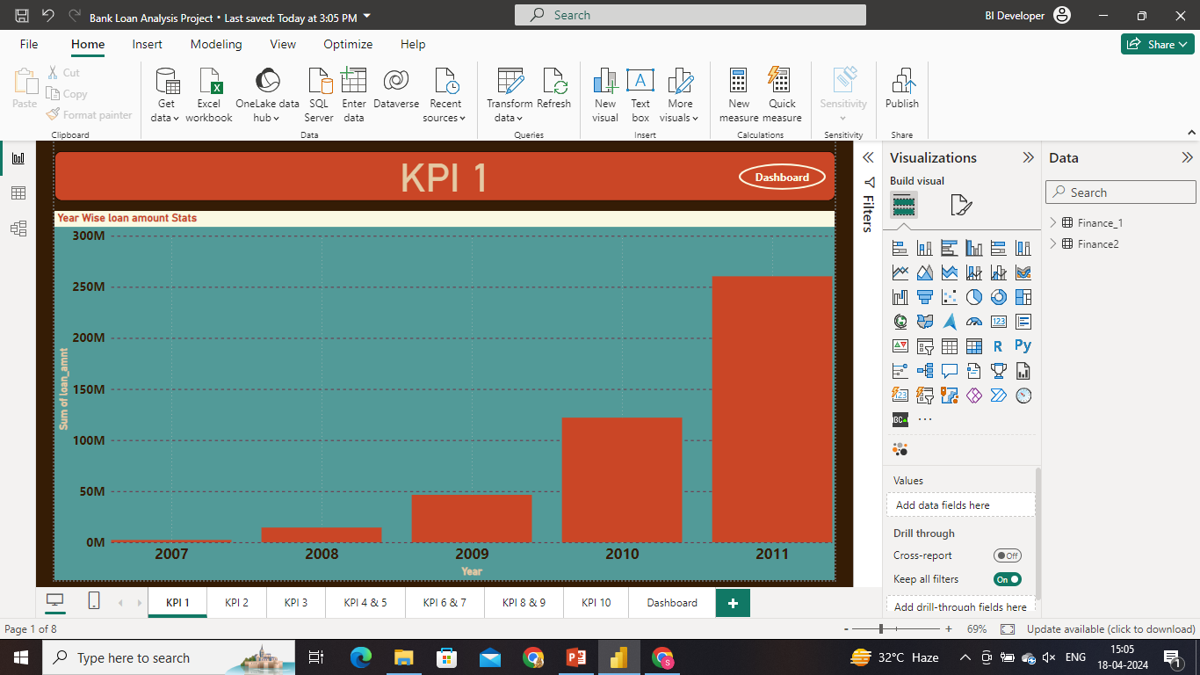

Slide 12
KPI Findings:
1. Year wise loan amount Stats:
As per our analysis the total Loan amount was increased year by year.
Year 2011 got the highest loan amount while
Year 2007 reflects the lowest amount

Slide 13
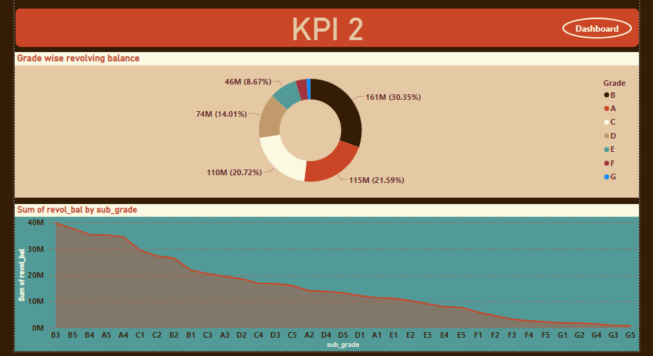

Slide 14
KPI Findings:
2. Grade and sub grade wise revolving balance:
In this Grade and subgrade wise revolving balance we can notice Grade-B have more revolving balance than any other Grades & Grade-G is lowest.
Grade-B customers has higher income , so higher the annual income lower the debt to income ratio hence more number of customers took loan in grade-b

Slide 15
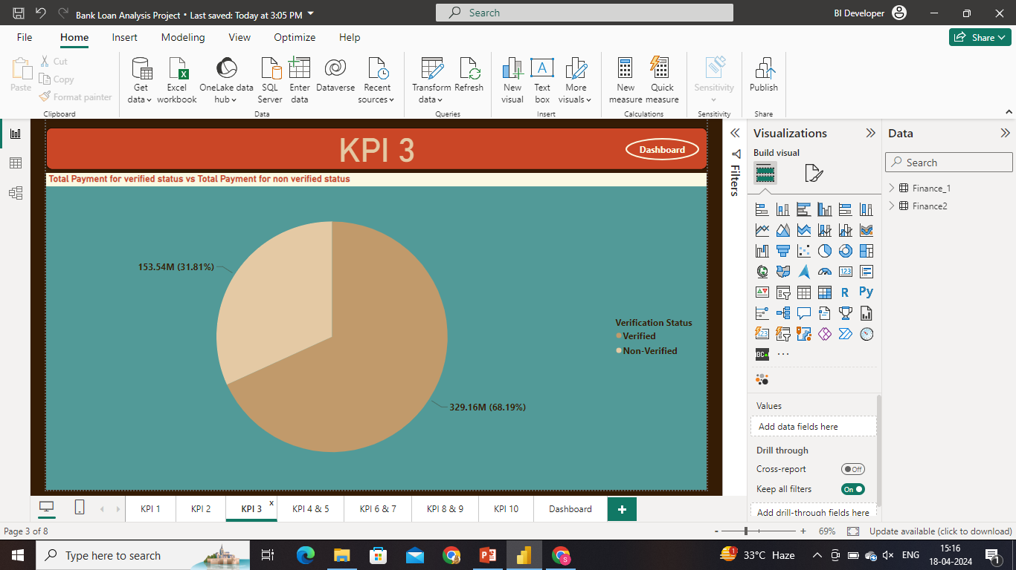

Slide 16
KPI Findings:
3. Total Payment for Verified Status Vs Total Payment for Non Verified Status:
This analysis helps bank to understand that how much amount of payment had been received via Verified method and Unverified method.
Although payment for unverified is less than verified bank needs to take action on these accounts because there will always be a risk that these accounts can create loss.

Slide 17
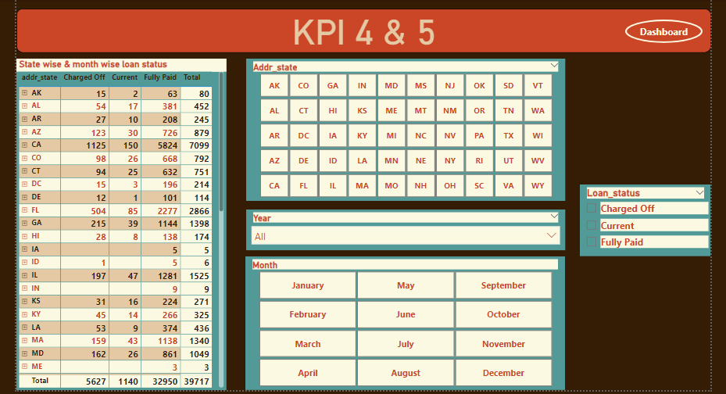

Slide 18
KPI Findings:
4 & 5. State wise loan status & Month wise loan status:
California(CA) state is at top fully paid loan status while Nebraska(NE) at bottom.
California(CA) state also has highest charged off loan status , lowest is Idaho(ID).
December is the top month where highest number of loans are issued

Slide 19
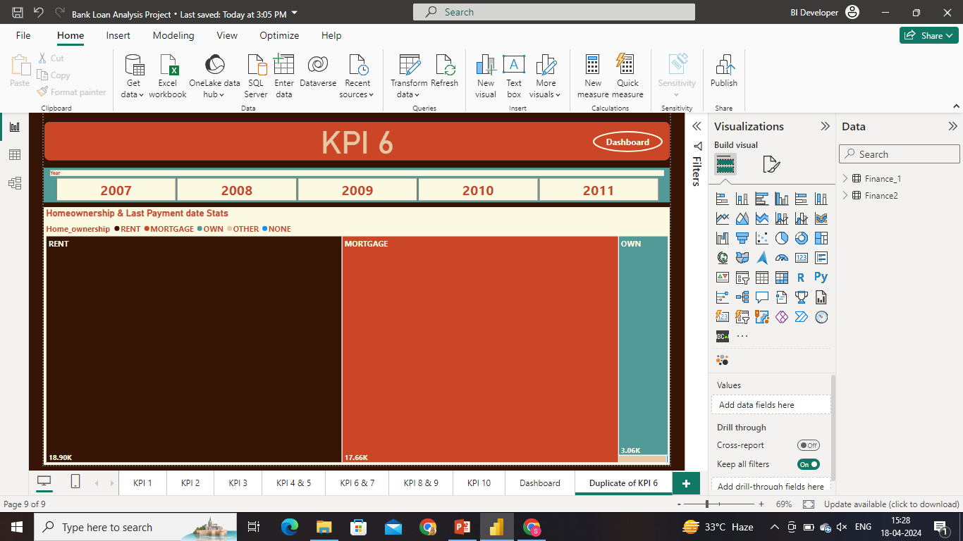

Slide 20
KPI Findings:
6. Homeownership & Last Payment date stats:
Overall large proportion of the dataset represents renters.
Renters are followed by homeowners paying off their mortgages.
This helps in temporal analysis of payment behavior, effect of economic conditions & to track interventions or policy changes.

Slide 21
Challenges:
1. Data Preparation: As power BI relies heavily on well-structured and cleaned data. We had to do some changes in power query editor like type of values, replace null values, adding custom column and grouping data.
2. Collaborating on Power BI project with group members was a challenge. Making changes in reports & visualizations was easily possible but changing any step in the power query editor was not possible for the other team members with whom the file was shared.
3. Compiling and selecting the best outcomes for the presentation
4. Different opinions and priorities to be gathered as a team for each task

Slide 22
Suggestions to overcome challenges:
Use Power Query Editor to clean and transform data before loading it into Power BI.
Use scheduled data refreshes and automated workflows to ensure your data is always up-to-date.
Share reports and dashboards through the Power BI Service for easy collaboration.
Organize content into workspaces and share access with appropriate team members.
Hold regular meetings to discuss progress, challenges, and any adjustments needed. Clear communication helps keep everyone aligned and addresses issues as they arise.
Encourage team members to share insights, tips, and best practices for Power BI. This helps improve the collective knowledge and efficiency of the group.
Create report and visualization templates that can be used by the entire team. This ensures consistency in the design and layout of reports.

Slide 23
Thank You

